Slide 1


Exhib
An exhibition Management System
Henrik Klarup
Jesper Riemer Andersen
Simon Reedtz Olesen
Jacob K. Wortmann
Nicklas Andersen

Slide 2
Agenda
Motivation
Concept
Application Design
Floor plan
Website
Server communication
Conclusion
Demonstration
2 OF 32 | 15.02.2014
Department of computer science
AALBORG UNIVERSITy

Slide 3
Motivation
Jacob K. Wortmann

Slide 4
Motivation
concept
App design
Floor plan
Website
Server communication
conclusion
demonstration
System Motivation
Single application with multiple purposes
Indoors navigation
relevant information to users
Simple administration Tool
4 OF 32 | 15.02.2014
Department of computer science
AALBORG UNIVERSITy
Notes:
- The motivation for our application is to make it easy for organisers of exhibitions to enter the mobile platform. With
a website tool to ease the creation and administration.
The users will have the same application for different exhibitions, so the user will not have download different application for different exhibitions.
- We would not exclude big indoors exhibitions, so navigation should also be possible indoors.
- We also don't want to spam the users of the application, so there should also be possible to personalise the application.
- It should'nt be hard to create an exhibition and manage it.

Slide 5
Concept
Jacob K. Wortmann

Slide 6
Motivation
concept
App design
Floor plan
Website
Server communication
conclusion
demonstration
The exhib Concept
Example: Exhibition
generate the floor plan and data
scan an NFC tag to enter
relevant information
Feeds
schedule of the exhibition
navigate to different booths
6 OF 32 | 15.02.2014
Department of computer science
AALBORG UNIVERSITy
Notes:
- So to show our application we decided to create an exhibition.
Firstly the organiser create the floor plan with our website tool, and while also doing creating data for the android application.
- When the exhibition is ready, users can scan a sepcial NFC tag to enter the exhibition.
- The user can subscribe to different booths to gain relavant information. The users receives information by feeds, the feeds are
created by booths. The users only receives feeds from booths they are subscribed to.
- The user can also see a schedule of the exhibition, that are sceduled ahead of time, this could be presentation of a new
product.
- With the help of the floor plan the user can also navigate to different booths, he uses the NFC tags to tell the application about
his current location.

Slide 7
Application Design
Simon Reedtz Olesen

Slide 8
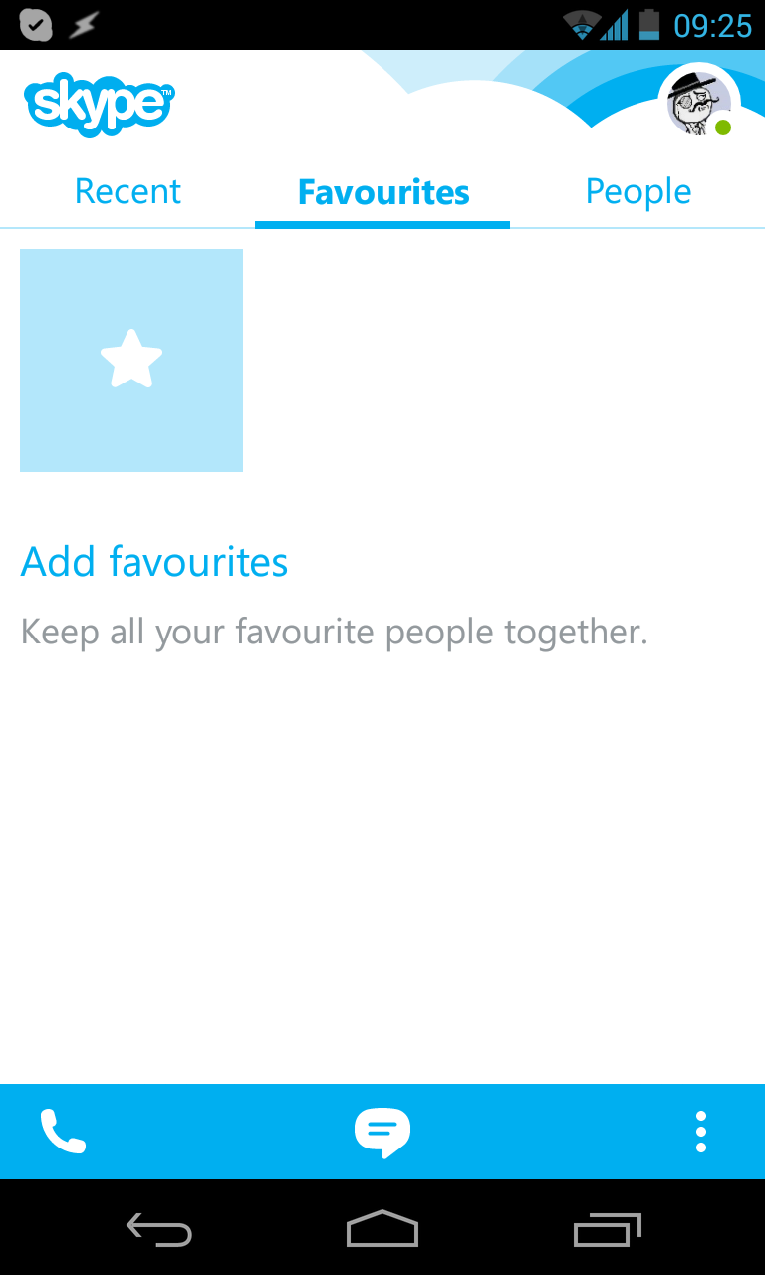
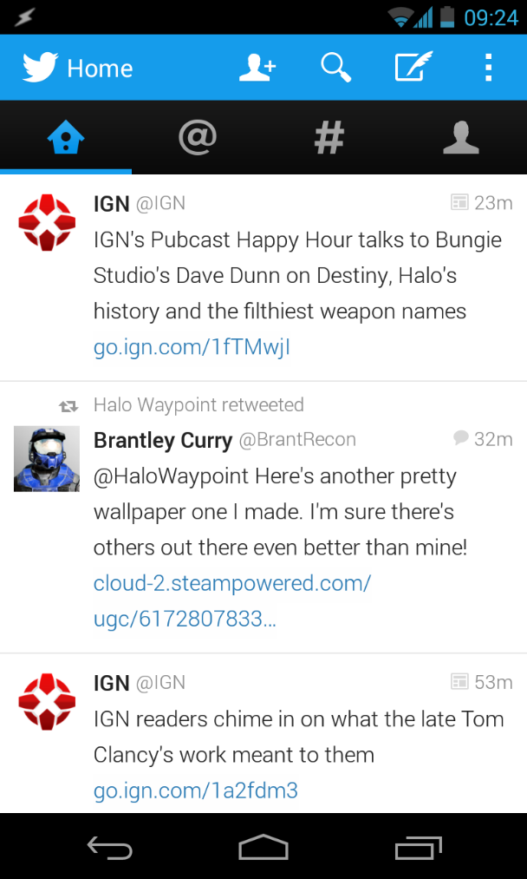
Motivation
concept
App design
Floor plan
Website
Server communication
conclusion
demonstration
Inspiration sources
Skype & Twitter
8 OF 32 | 15.02.2014
Department of computer science
AALBORG UNIVERSITy

Slide 9
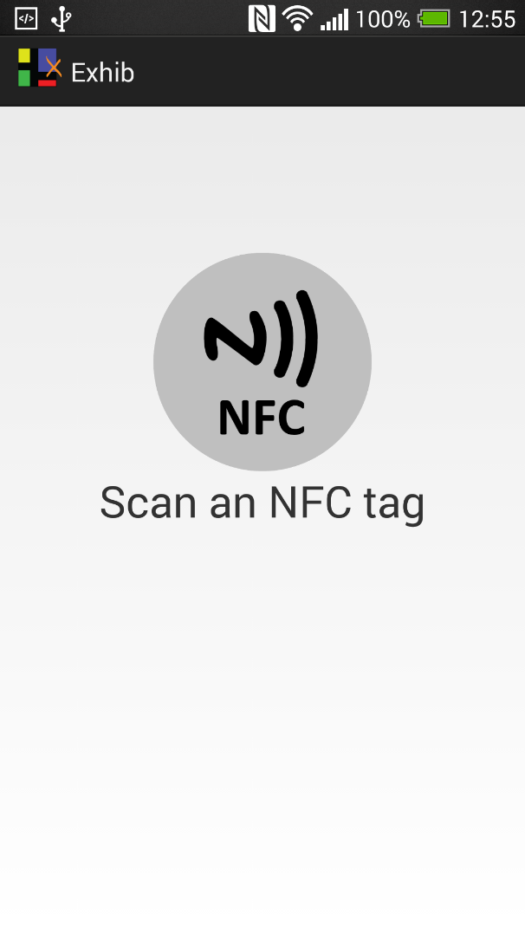
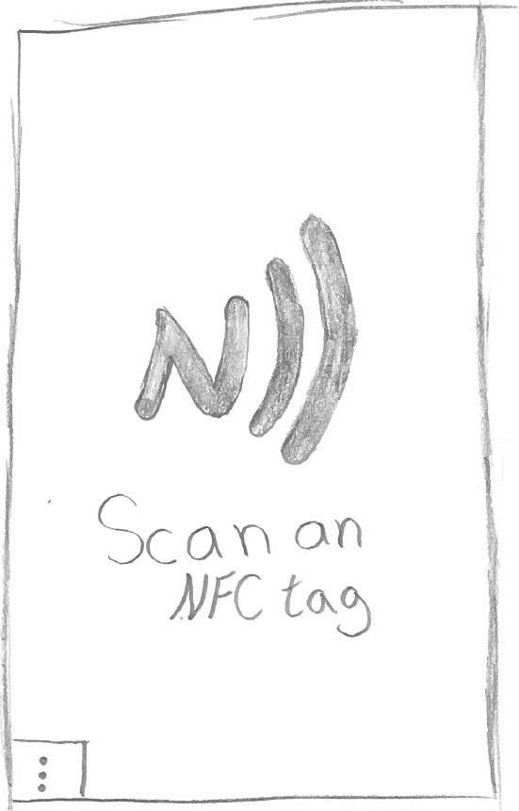
Motivation
concept
App design
Floor plan
Website
Server communication
conclusion
demonstration
Start screen
9 OF 32 | 15.02.2014
Department of computer science
AALBORG UNIVERSITy

Slide 10
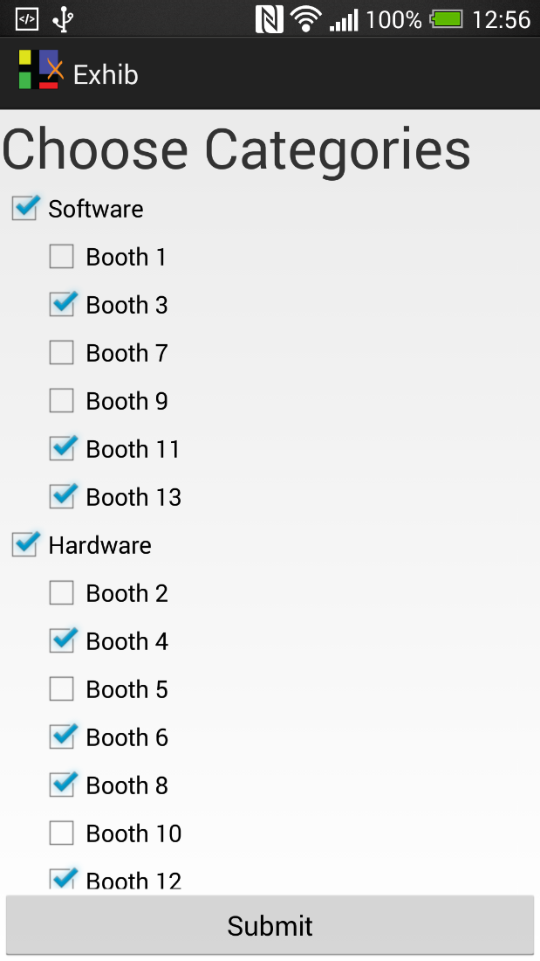
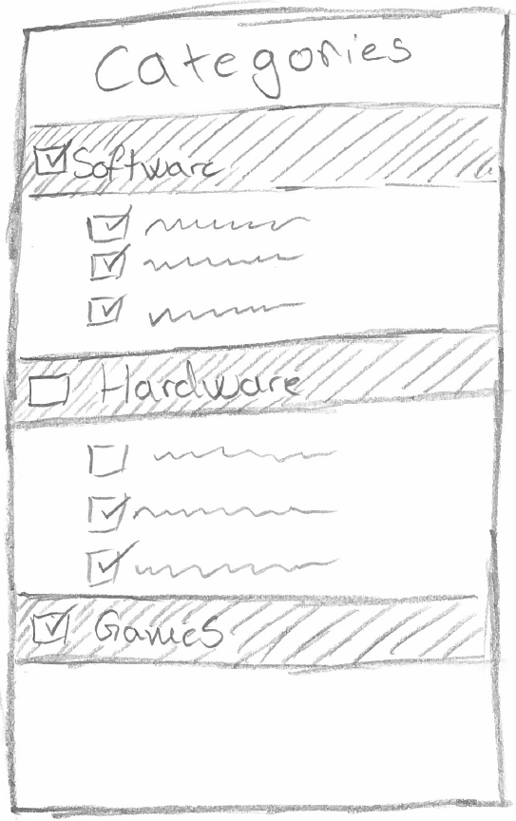
Motivation
concept
App design
Floor plan
Website
Server communication
conclusion
demonstration
Categories
10 OF 32 | 15.02.2014
Department of computer science
AALBORG UNIVERSITy

Slide 11
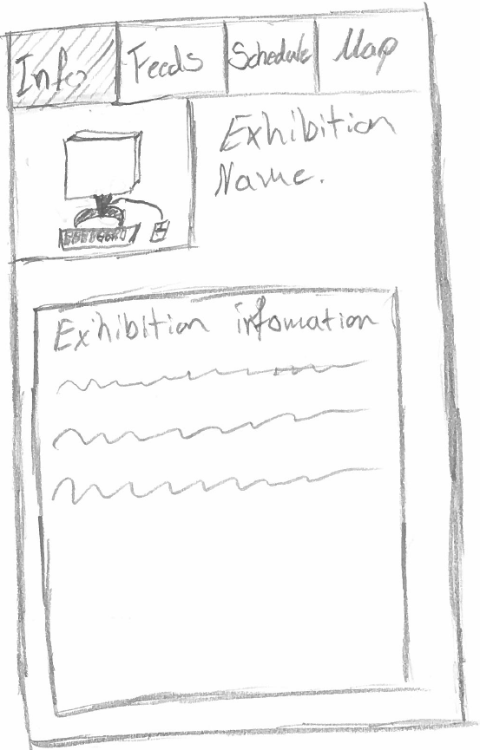
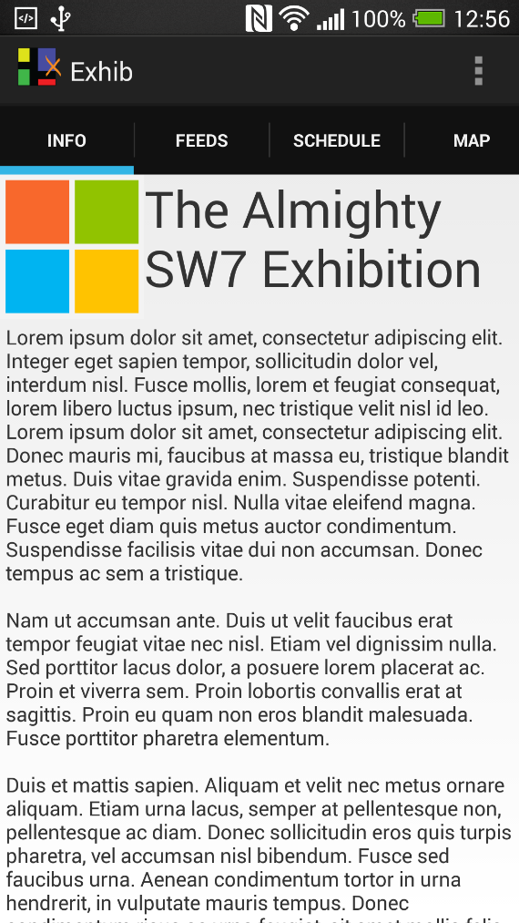
Motivation
concept
App design
Floor plan
Website
Server communication
conclusion
demonstration
Event Information
11 OF 32 | 15.02.2014
Department of computer science
AALBORG UNIVERSITy

Slide 12
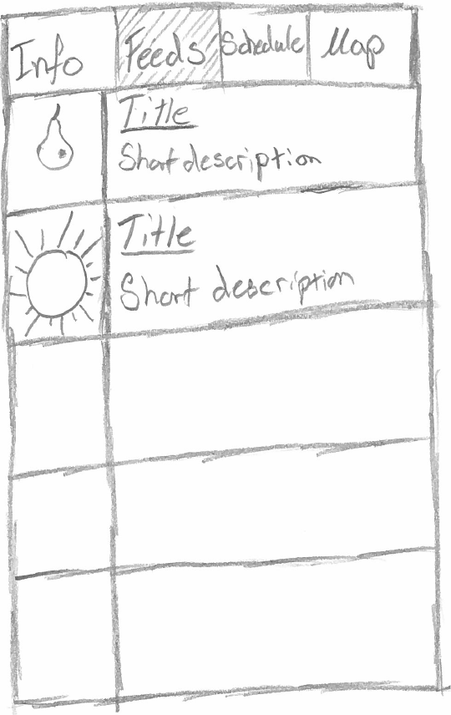
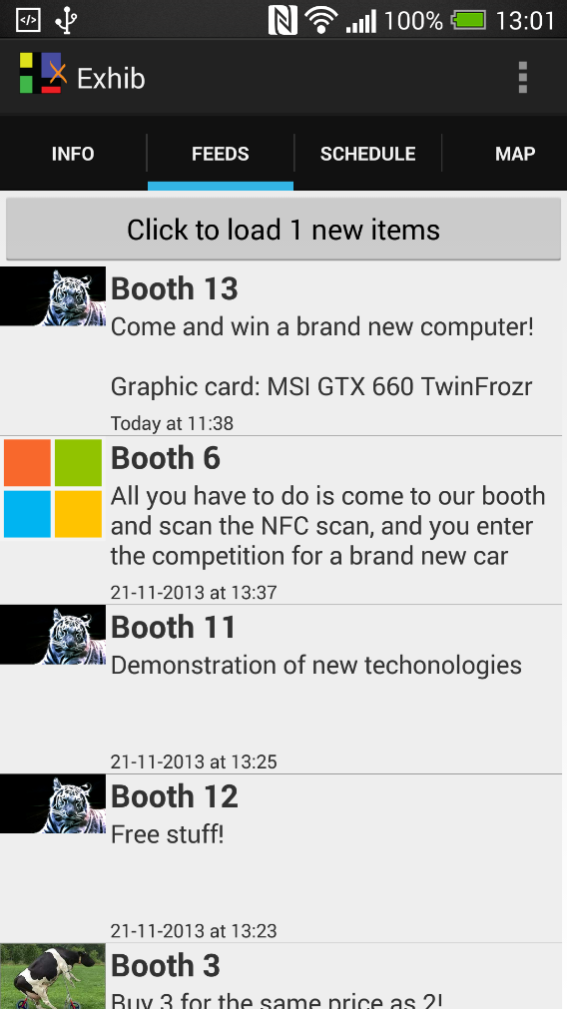
Motivation
concept
App design
Floor plan
Website
Server communication
conclusion
demonstration
Feeds
12 OF 32 | 15.02.2014
Department of computer science
AALBORG UNIVERSITy

Slide 13
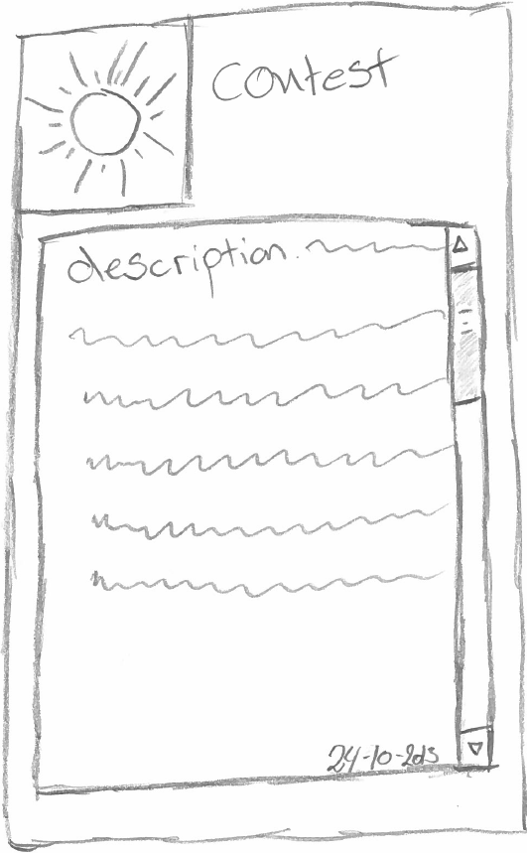
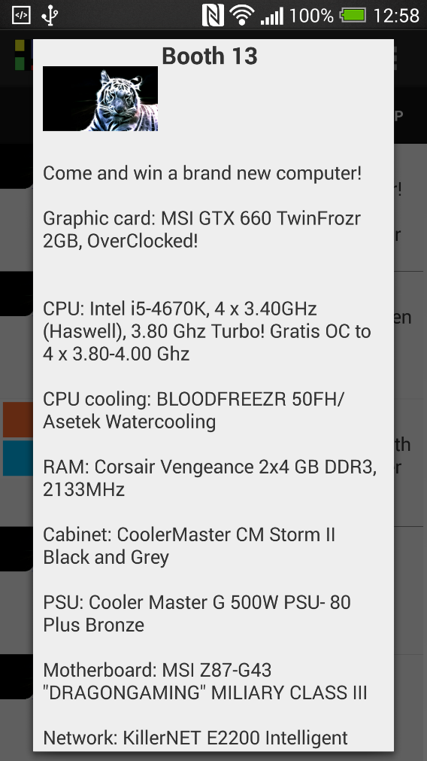
Motivation
concept
App design
Floor plan
Website
Server communication
conclusion
demonstration
Feed popup
13 OF 32 | 15.02.2014
Department of computer science
AALBORG UNIVERSITy

Slide 14
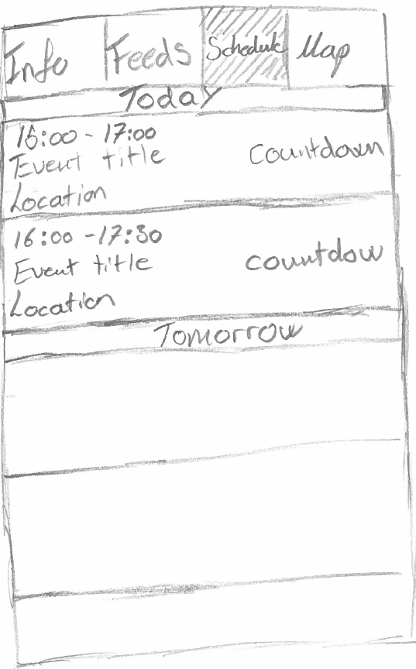
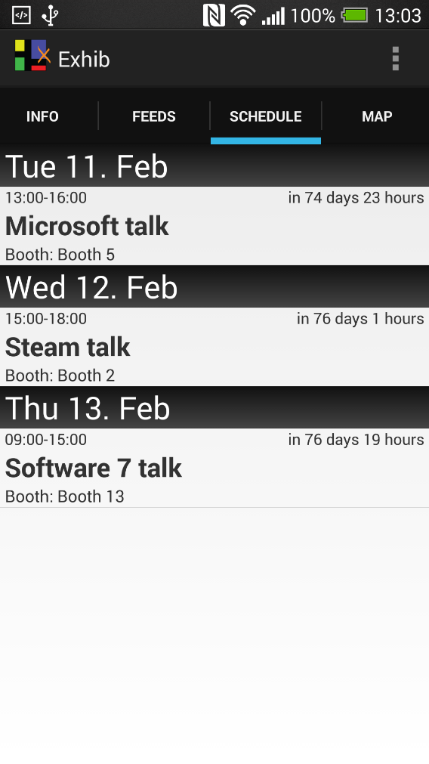
Motivation
concept
App design
Floor plan
Website
Server communication
conclusion
demonstration
Schedule
14 OF 32 | 15.02.2014
Department of computer science
AALBORG UNIVERSITy

Slide 15
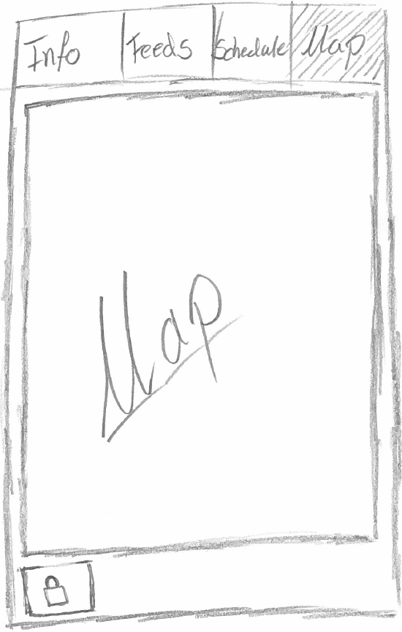
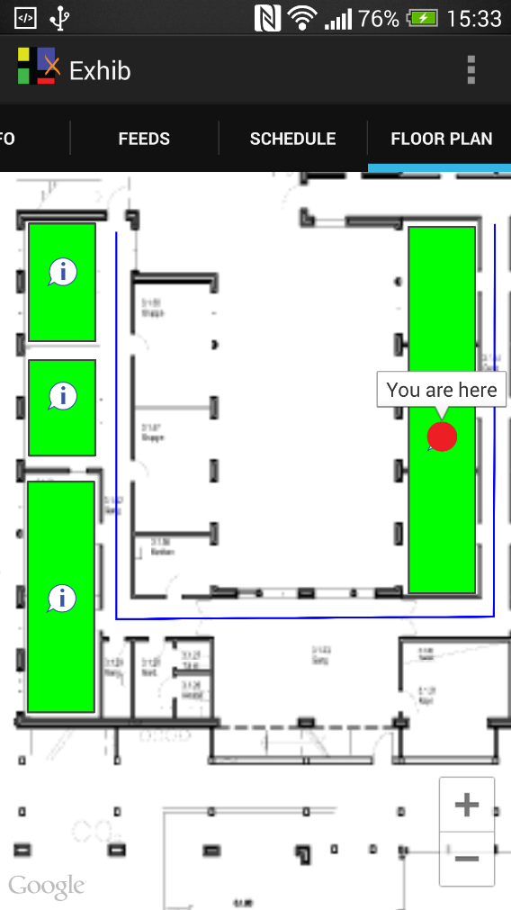
Motivation
concept
App design
Floor plan
Website
Server communication
conclusion
demonstration
Floor Plan
15 OF 32 | 15.02.2014
Department of computer science
AALBORG UNIVERSITy

Slide 16
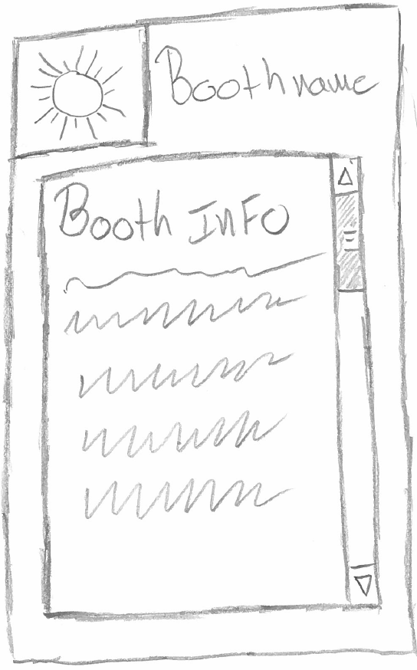
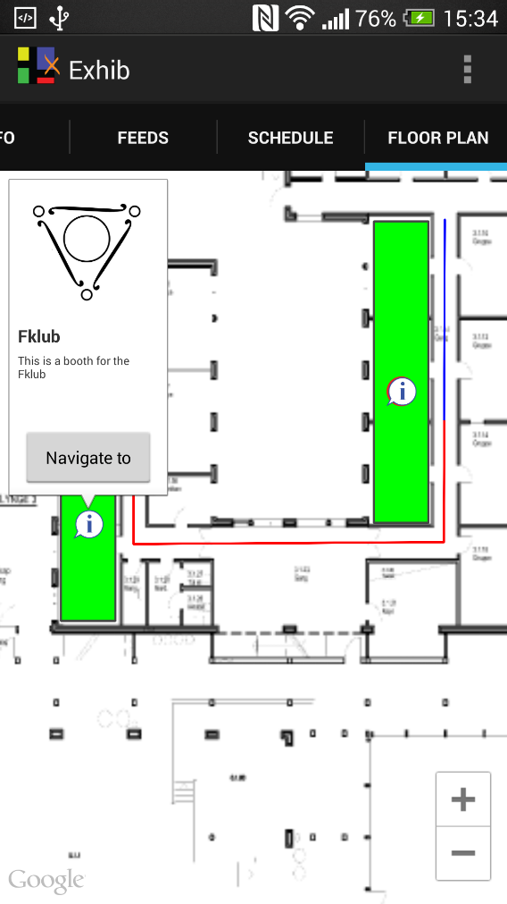
Motivation
concept
App design
Floor plan
Website
Server communication
conclusion
demonstration
Floor Plan
16 OF 32 | 15.02.2014
Department of computer science
AALBORG UNIVERSITy

Slide 17
Floor Plan
Jesper R. Andersen

Slide 18
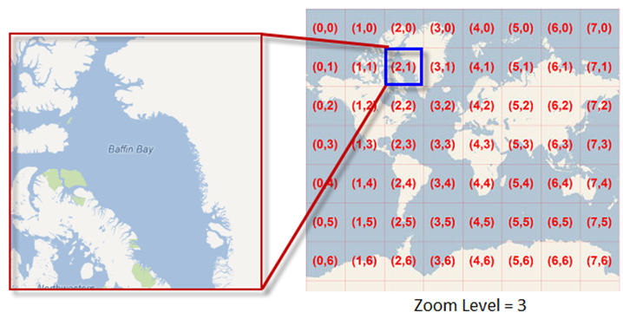
Motivation
concept
App design
Floor plan
Website
Server communication
conclusion
demonstration
Floor plan
Webview vs. mapfragment
Performance
Tile set
18 OF 32 | 15.02.2014
Department of computer science
AALBORG UNIVERSITy

Slide 19
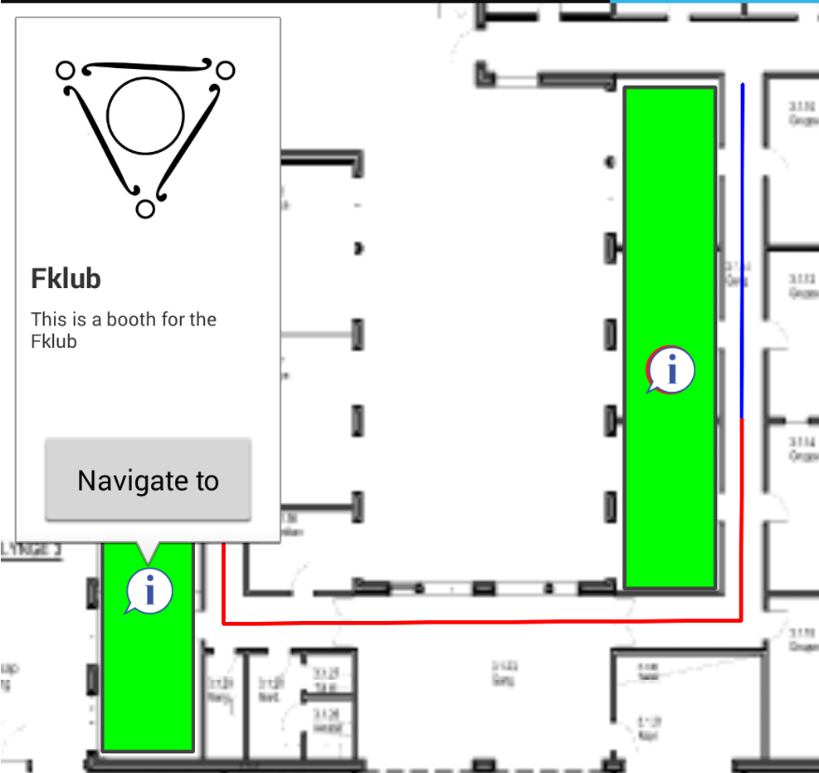
Motivation
concept
App design
Floor plan
Website
Server communication
conclusion
demonstration
Floor plan
shapes and elements
MaRkers
Polygons
Polylines
Info window
19 OF 32 | 15.02.2014
Department of computer science
AALBORG UNIVERSITy

Slide 20
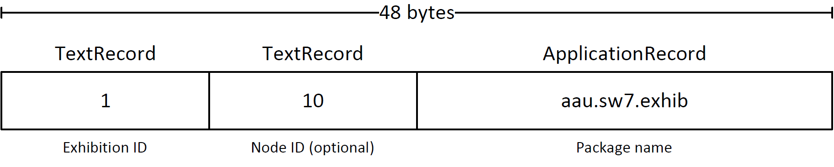
Motivation
concept
App design
Floor plan
Website
Server communication
conclusion
demonstration
NFC
NFC Tag data
Exhibition registration
Booth redirection
NFC implementation
Foreground dispatcher
20 OF 32 | 15.02.2014
Department of computer science
AALBORG UNIVERSITy

Slide 21
Website
Henrik Klarup

Slide 22
Motivation
concept
App design
Floor plan
Website
Server communication
conclusion
demonstration
website Tool
Administration tool
Feeds
Company
Exhibition
Schedule
Floor plan
22 OF 32 | 15.02.2014
Department of computer science
AALBORG UNIVERSITy

Slide 23
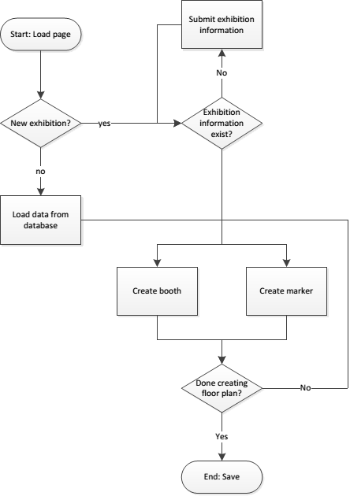
Motivation
concept
App design
Floor plan
Website
Server communication
conclusion
demonstration
Website flow
23 OF 32 | 15.02.2014
Department of computer science
AALBORG UNIVERSITy

Slide 24
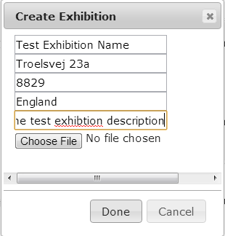
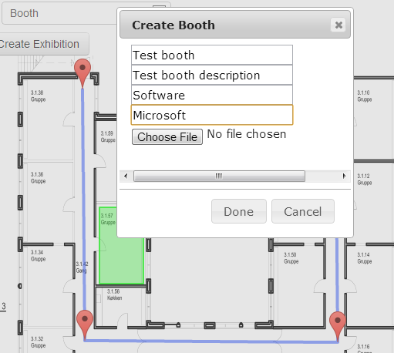
Motivation
concept
App design
Floor plan
Website
Server communication
conclusion
demonstration
Website creation
24 OF 32 | 15.02.2014
Department of computer science
AALBORG UNIVERSITy

Slide 25
Motivation
concept
App design
Floor plan
Website
Server communication
conclusion
demonstration
Features of the website
Features
Create and edit exhibitions
Create feeds and schedules
Create an exhibition floor plan
Future work
Login system
Automatic tile creation from website
25 OF 32 | 15.02.2014
Department of computer science
AALBORG UNIVERSITy

Slide 26
Server Communication
Nicklas Andersen

Slide 27
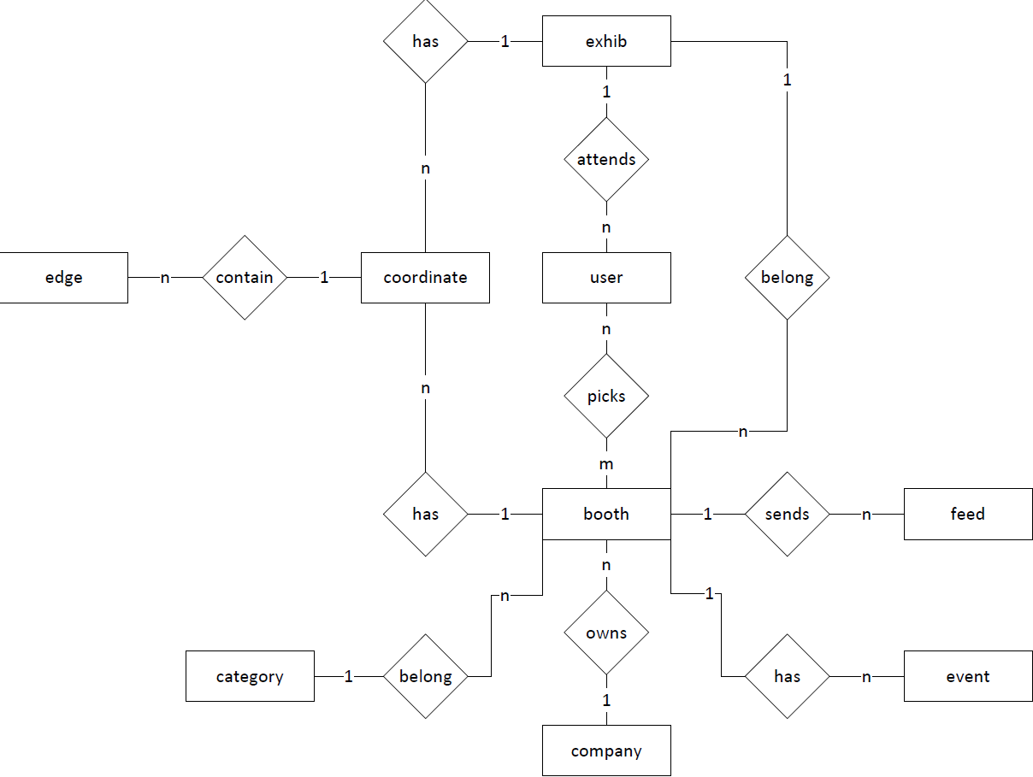
Motivation
concept
App design
Floor plan
Website
Server communication
conclusion
demonstration
Database
ER DIAGRAM
27 OF 32 | 15.02.2014
Department of computer science
AALBORG UNIVERSITy

Slide 28
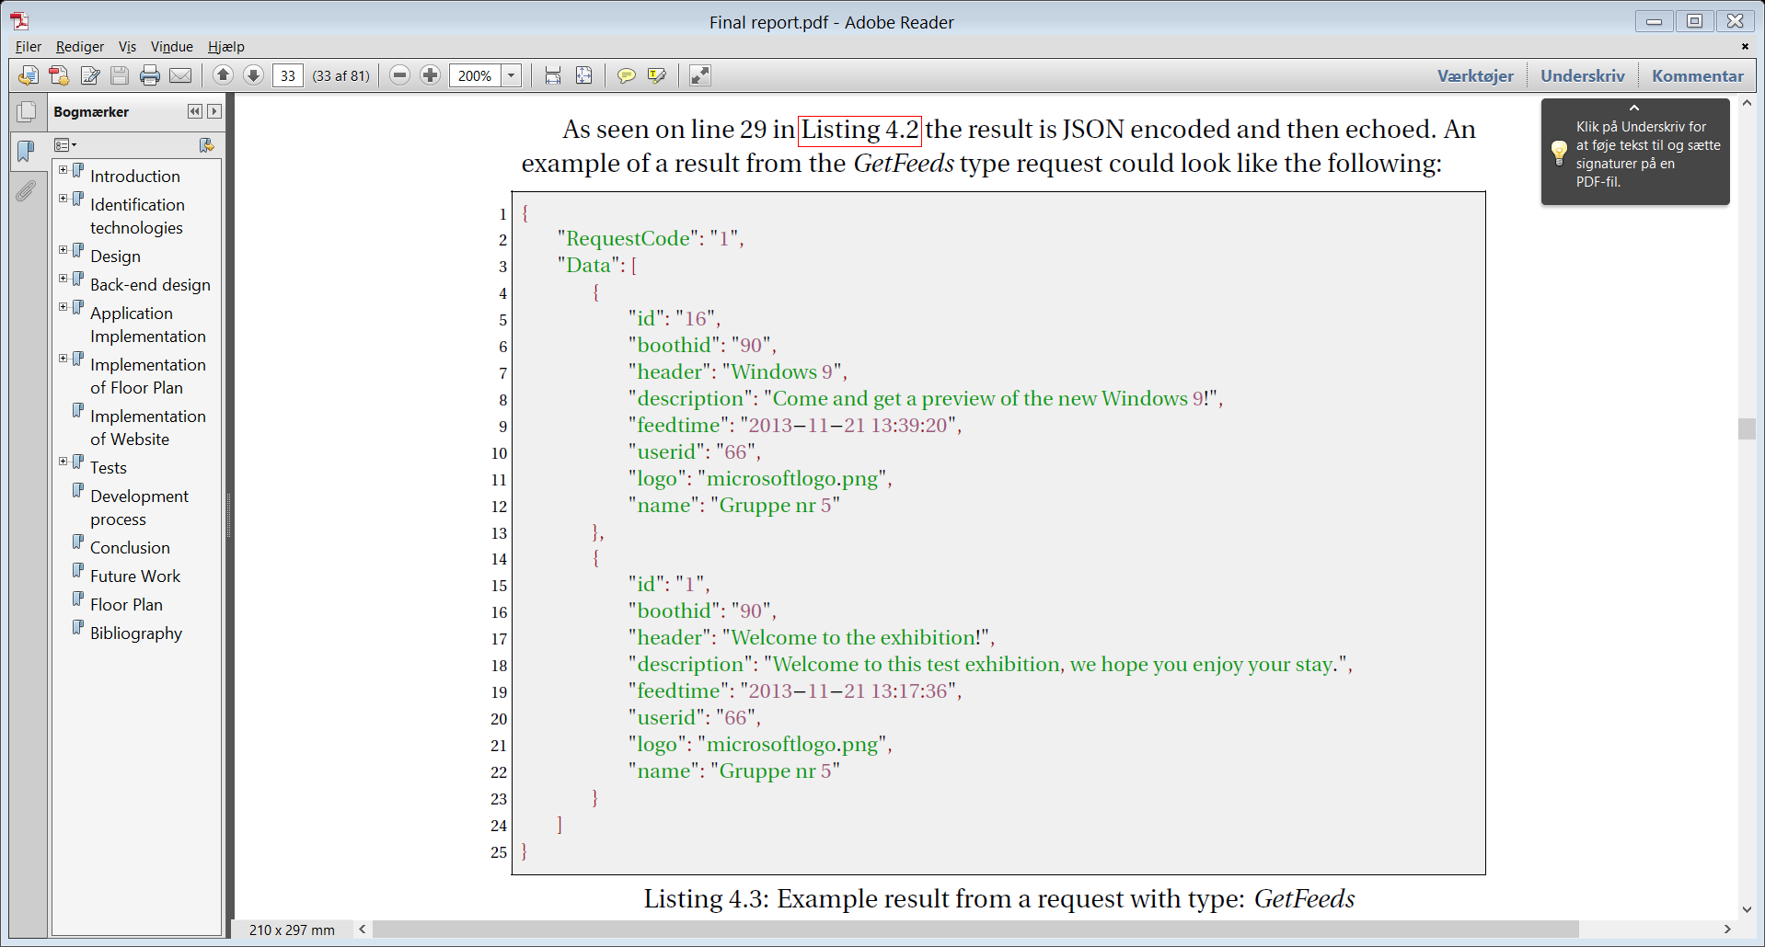
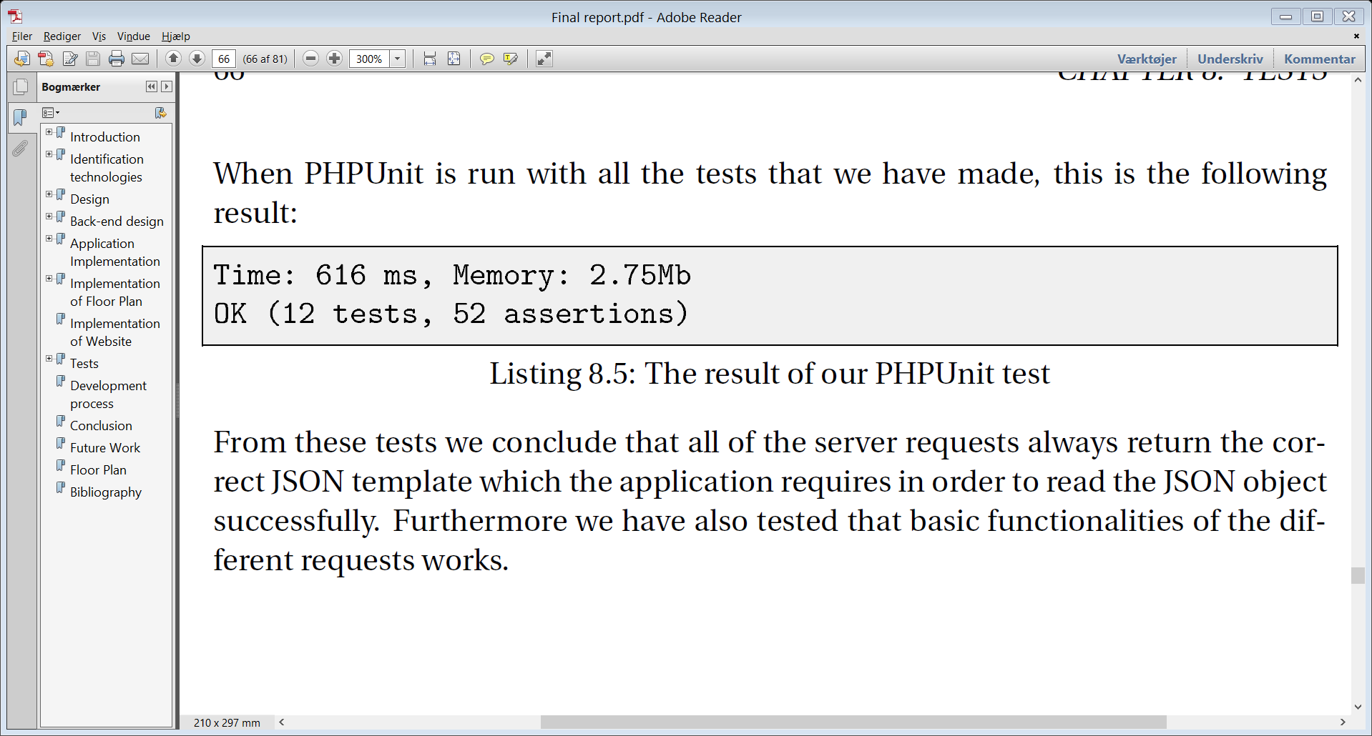
Motivation
concept
App design
Floor plan
Website
Server communication
conclusion
demonstration
API
API Parameters
Request Code
Type
User id
Limit
Timestamp
Exhib Id
Example
requestcode = 1
Type = Getfeeds
User id = 1
Limit = 6
Unit Testing
28 OF 32 | 15.02.2014
Department of computer science
AALBORG UNIVERSITy

Slide 29
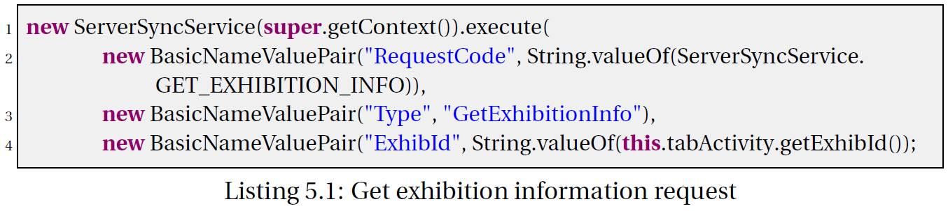
Motivation
concept
App design
Floor plan
Website
Server communication
conclusion
demonstration
Serversyncservice
Asynchronous
Request code
29 OF 32 | 15.02.2014
Department of computer science
AALBORG UNIVERSITy

Slide 30
Conclusion
Jacob K. Wortmann

Slide 31
Motivation
concept
App design
Floor plan
Website
Server communication
conclusion
demonstration
Conclusion
implemented website tool, android application, and a server service
Personalise the application
The three parts functions and work well with each other
WE believe that the application will help navigation issues
Future work
31 OF 32 | 15.02.2014
Department of computer science
AALBORG UNIVERSITy
Notes:
- We implemented all the three parts of the system, we did this to get a more final result at the end of the semester, but also to
gain knowledge and experiance with different technologies, and the difficulty of getting them to work together.
- The user can personilise the information that is recieved by subscribing to booths of their liking, meaning that
they will not get spam from booths that they are of no interest.
- We have tested the Server Communication layer and found that it always returns a valid JSON format to the application,
We have also tested the android application, and found that its functionalities works.
- We believe that the application will help and help users with navigation, but also aid the users to get a better overview
of the exhibition.
- Since we implemented all three parts of the system, means that there are a lot of good features that can implemented
to further extend the capabilities of the application.

Slide 32
Demonstration
Henrik Klarup

